Slide 1

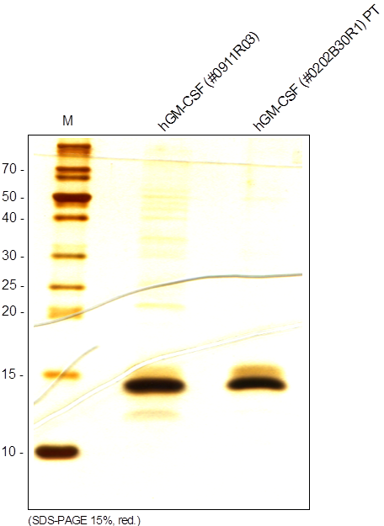
ReliaTech GmbH
Recombinant human GM-CSF
(Cat #200-004 / -005 )
Fig. 1: SDS-PAGE analysis of recombinant human GM-CSF derived from E. coli. Sample was loaded in 15% SDS-polyacrylamide gel under reducing conditions and stained with Silver stain.
http://www.reliatech.de / orders@reliatech.de

